Slide 1
Linux Fundamentals
AWS re:Start

Slide 2


Linux Fundamentals Course Overview
Lesson 1: An Introduction to Linux
Lesson 2: Linux Login Sessions
Lesson 3: Working with Files and Directories
Lesson 4: Working with Text
Lesson 5: Users and Groups
Lesson 6: Managing File Permissions
Lesson 7: Editing Files
Lesson 8: Managing Processes
Lesson 9: Managing Services
Lesson 10: Managing Networking
Lesson 11: Software Management
Lesson 12: Managing Log Files
Lesson 13: Working with Files
Lesson 14: The Bash Shell
Lesson 15: Bash Shell Scripts
Course Lessons

Slide 3
Linux Fundamentals Course Overview
Lesson 1: An Introduction to Linux
Lesson 2: Linux Login Sessions
Lesson 3: Working with Files and Directories
Lesson 4: Working with Text
Lesson 5: Users and Groups
Lesson 6: Managing File Permissions
Lesson 7: Editing Files
Lesson 8: Managing Processes
Lesson 9: Managing Services
Lesson 10: Managing Networking
Lesson 11: Software Management
Lesson 12: Managing Log Files
Lesson 13: Working with Files
Lesson 14: The Bash Shell
Lesson 15: Bash Shell Scripts
The Linux Operating System
Anatomy of an Operating System
Hardware and Operating Systems
CLI vs. GUI
Linux Keywords
Man Pages
The Linux Shell
Linux Distributions

Slide 4
Opening
Connections and Predictions
Connection to Behavioral Skills and Mindsets
Objectives and Overview
Behavioral Skill: Teamwork Mindset: Personal Responsibility

Slide 5
Module 1: An Introduction to Linux
After completing this module, you will be able to:
List the characteristics and components of the Linux operating system
Describe the functions of the Linux Kernel
Explain the differences between a command-line interface (CLI) and a graphical user interface (GUI)
Define several Linux keywords, including FOSS, server, and client
Explain Linux command syntax, including how to use man pages to reference information about Linux commands
Explain shells and the Linux boot loader
Identify the strengths of different Linux distributions
Behavioral Skill: Time Management Mindset: Personal Responsibility
5

Slide 6
The Linux Operating System
Open source
Design is publicly available and can be modified and expanded by users
Uses tools and utilities to accomplish tasks
Available for multiple users and multi-tasking
Built to handle networking

Slide 7
Linux History
Created in 1991 by Linus Torvalds
Very modular
Very stable
Very common as a server operating system
Can be used as a desktop operating system

Slide 8
Anatomy of an Operating System
Kernel
Provides the core functionality of the operating system
Daemons
Provide additional support for the system or the user
Applications
Programs, such as text editors, web browsers, databases
Configuration files
Settings for Linux, services, and applications stored in text files
Data files
End-user content, such as text files, music files, image files

Slide 9
The Linux Kernel
An operating system kernel is
A computer program
Controls everything in the operating system
Kernel
Memory
Processes
Devices
Resource allocation
File system access
The Linux kernel manages
Scheduling of processor time
Memory allocation for the operating system and for applications
Access to peripheral devices (sound card, hard disk drive, network card, etc.)
Functions of the kernel

Slide 10



Daemons
Computer program
Runs background program process
Not under control of an interactive user
Process names traditionally end with d
Examples:
syslogd
sshd
Daemons are sometimes referred to as services

Slide 11

Applications
Software designed to help a user by grouping sets of tasks, functionalities, or activities
Examples:
Word processor
Web browser
Email client
Media player
Often referred to as apps
A
A
A
A
A
A

Slide 12



Configuration Files
Configure parameters and initial settings for computer programs
Some config files run a set of commands at startup
Common filename extensions:
.cnf
.conf
.cfg
.cf
.ini

Slide 13





Data Files
Groups of data available to the end user
Examples:
Music file
Text file
Image file

Slide 14

Check for Understanding
Reflect on the content just explored as a group.
Using your own words, how would you summarize the most crucial pieces of information?
How will you interact and engage with this content as a Cloud Support Engineer?
Which behavioral skills and mindsets will support your ability to effectively use this content as a Cloud Support Engineer?
Options to share: Written Response, Turn & Talk, Whole Class Debrief, Instructor Choice!

Slide 15
Hardware and Operating Systems
Hardware—four major subsystems:
CPU
RAM
Storage
Networking
Operating system (OS):
Interface between user and hardware
OS runs applications

Slide 16
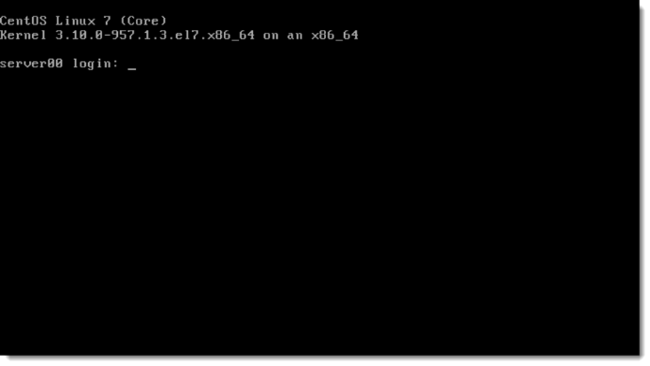
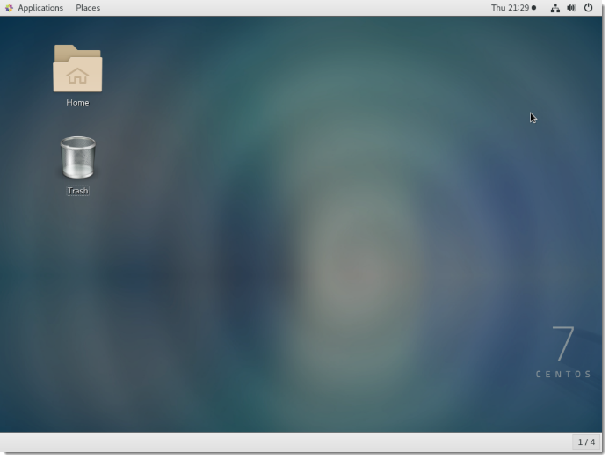
CLI vs. GUI (1 of 2)
Command-line interface usually far more efficient:
Consumes less hardware resources
Can be automated with scripts
Provides more options
Most Linux servers only use the CLI
Graphical user interface easier to use:
Easy and intuitive to navigate
Similar in Linux, Windows, macOS
Most end-user workstations use the GUI

Slide 17

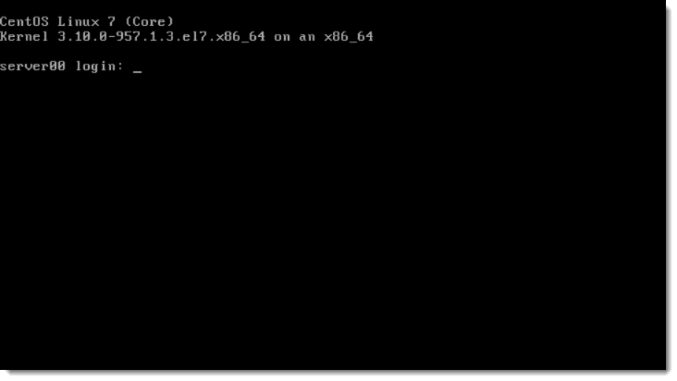
CLI vs. GUI (2 of 2)
Why use the GUI?
Easy
Intuitive
Comfortable
Why use the command-line interface (CLI)?
Faster
More options and more flexible
Offers more efficient use of hardware
Reality—each used for different tasks
The focus of this course is the CLI

Slide 18

The Graphical User Interface in Linux
GUI consumes a lot of resources, and on a server, resources could instead be dedicated to providing service
Example: A busy web server should not waste resources providing a pretty desktop environment, but rather should dedicate those resources to servicing web connections
GUI considered to be optional in Linux, especially for a server
Windows and macOS: GUI almost always integrated and not optional
Microsoft and Apple provide single, integrated GUI with minimal options
GUI usually oriented on end-user workstations

Slide 19
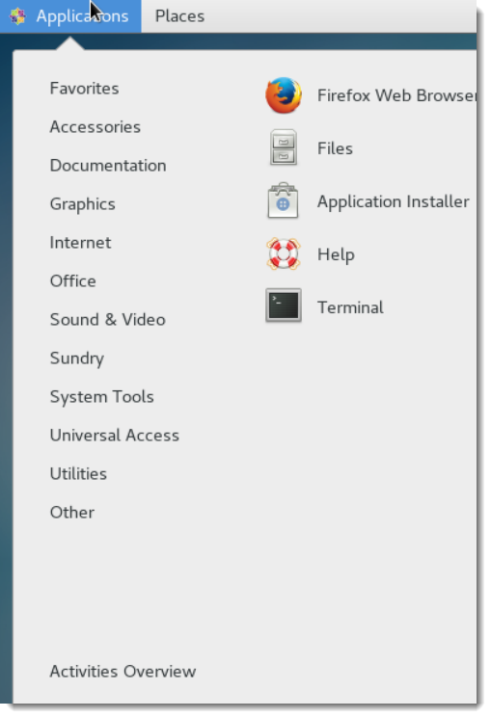
A Few Basic Features
Access the Terminal
Network, firewall, updates, hardware resources, etc.
Change the look and feel—desktop, etc.

Slide 20
Differences between Linux and Windows
Different operating system kernels
Different application support
Linux distributions have a different business model than Microsoft
Windows requires licenses that restrict the distribution of the operating system
Linux is licensed as "open source," meaning it can be freely distributed and it can be freely modified

Slide 21
Linux Keywords
Free and open source (FOSS)—describes the licensing and overall approach of Linux and Linux software development
Server vs. client:
Servers provide services—Ex: web server provides a website
Clients consume services—Ex: web client accesses a website
Major Linux vendors:
Red Hat
Debian
Ubuntu
CentOS Project

Slide 22
Activity 1-1: The Linux Operating System
Overview
In this activity, you will answer questions related to:
The benefits of Linux
Differences between Linux and Windows
Licensing
Linux interfaces (CLI vs. GUI)
Instructions
To complete the activity, answer the questions in your student guide.

Slide 23
Activity 1-1: The Linux Operating System
Debrief
What are some of the benefits of using Linux?
Are there any disadvantages to using Linux? If so, what are they?
How is Linux different from Microsoft Windows?
What benefits might come from free and open source software (FOSS) development?
Why would administrators managing Linux servers not want to use a graphical user interface (GUI)?
Have you used Linux before?

Slide 24

Man Pages
Most Linux documentation and help contained in manual or "man" pages
Provides brief summary of use, syntax, and options associated with a particular command
When you ask a Linux person for help:
Did you check the man page?

Slide 25
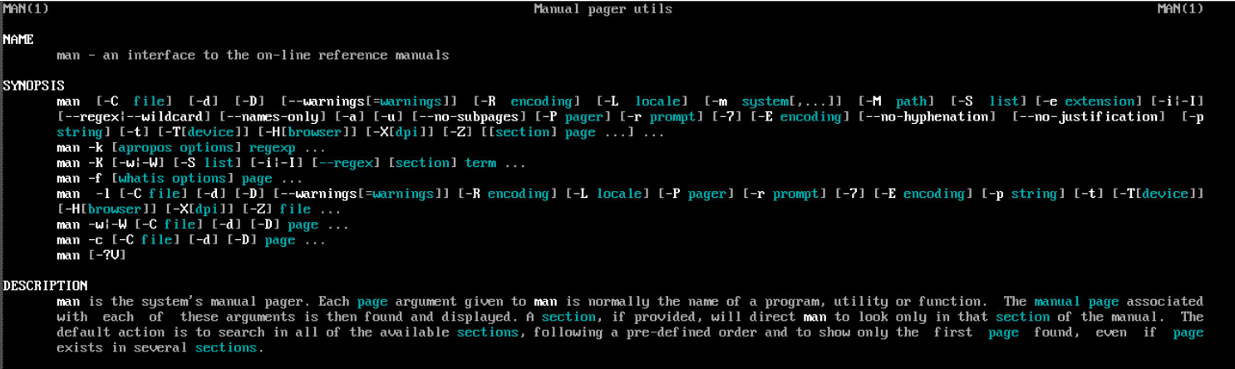
The man Command (Slide 1 of 2)
Syntax: man <command name>
The man man command:

Slide 26
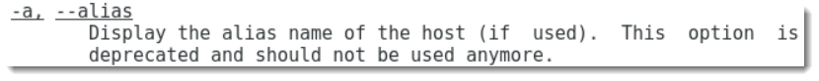
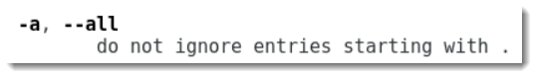
The man Command (Slide 2 of 2)
Primary use of man pages to reference command options
Each command has different options (are often not consistent with each other)
-a option for the hostname command:
-a and --alias are the same for hostname
-a option for the ls command:
-a and --all are the same for ls

Slide 27

The Shell
User interacts with the shell
Kernel
Memory
Processes
Devices
Resource allocation
File system access
Shell interacts with the kernel

Slide 28
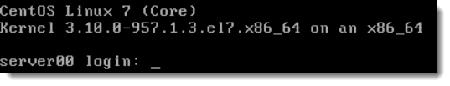
Shells
Bash shell is the default Linux shell
Typically the only shell you need to know for Linux
The only shell covered in this course
Each shell has own syntax, or way of formatting commands
Shell provides the command prompt
Shell | Description
sh | The original Bourne shell for Unix.
bash | The "Bourne-again shell"—the default Linux shell.
ksh | The KornShell, a common Unix shell.

Slide 29
Boot Loader / Boot Process
BIOS processed when machine is powered on
Master boot record (MBR) checked to find partition where operating system files stored
GRUB 2 boot loader begins process of loading Linux kernel into memory
Kernel takes over boot process and begins loading services and daemons
systemd initialization process begins loading services and daemons, referencing configuration files
Linux boots to a target startup configuration—either a command-line interface (CLI) or a graphical user interface (GUI)
User logs in to system

Slide 30
Check for Understanding
Reflect on the content just explored as a group.
Using your own words, how would you summarize the most crucial pieces of information?
How will you interact and engage with this content as a Cloud Support Engineer?
Which behavioral skills and mindsets will support your ability to effectively use this content as a Cloud Support Engineer?
Options to share: Written Response, Turn & Talk, Whole Class Debrief, Instructor Choice!

Slide 31
Activity 1-2: The Linux Kernel and Linux Shells
Overview
Most of your interaction with Linux will be using the command-line interface (CLI). In Linux, the CLI environment is the Bash shell.
Instructions
To complete the activity, answer the questions in your student guide.

Slide 32
Activity 1-2: The Linux Kernel and Linux Shells
Debrief
Is the Bash shell the default for most Linux distributions?
Do you think it is an advantage that if you learn Bash on one Linux system, you can apply what you've learned to other Linux systems?
What is "shell syntax"?

Slide 33



Distributions
Many "kinds" of Linux, referred to as distributions or distros
Distro: a purpose-specific Linux version
Examples: RHEL vs. Kali vs. Ubuntu Studio
Because Linux is open source, anyone can make a distribution and tailor for a given purpose
Usually a free download

Slide 34

Red Hat vs. Debian
Distributions usually based on either Red Hat Linux or Debian Linux
Common Red Hat derivatives:
Fedora
CentOS
Amazon Linux
Common Debian derivatives:
Ubuntu
Linux Mint
Kali Linux

Slide 35

Amazon Linux
Designed for use on Amazon Web Services (AWS) virtual machines
Enterprise-class Linux distribution
Derived from Red Hat Enterprise Linux (RHEL)

Slide 36

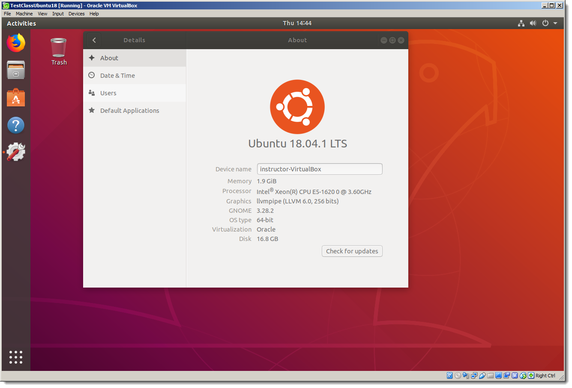
Ubuntu Linux
Very common and very popular Linux distribution
Easy and flexible
Great Linux distribution for home use or for those new to Linux

Slide 37
CentOS
Community Enterprise Operating System
A Linux distribution
Free
Enterprise-class
Community-supported
Functionally compatible with its upstreamsource and Red Hat Enterprise Linux (RHEL).

Slide 38
Activity 1-3: Linux Distributions
Overview
One of the many ways in which Linux differs from Microsoft Windows and Apple macOS is that anyone can create their own Linux version. These versions are usually purpose-specific and referred to as distributions, or "distros." In this activity, you will identify distribution characteristics.
Instructions
To complete the activity, answer the questions in your student guide.

Slide 39
Activity 1-3: Linux Distributions
Debrief
What are the two main branches of the Linux family?
What is the primary difference between these two branches?
List a few distributions that are derived from Red Hat Linux.
List a few distributions that are derived from Debian Linux.
Amazon Linux, used by Amazon Web Services (AWS), is derived from which branch?
Ubuntu Linux, a very popular and easy Linux distribution, is derived from which branch?
Which distribution are you using in class?

Slide 40

Let’s Practice!
Your instructor will explain the following practice activity intended to solidify your understanding.
Be prepared to debrief the experience when the whole group comes back together!
Options for Practice: You Teach, Quiz a Friend, Pitch It, How May I Help You?, Instructor Choice!

Slide 41

Lab 0: Connect to Global Knowledge Remote Labs
Overview
All labs and activities in this course that require that you complete actions in a Linux environment will be performed via the Global Knowledge Remote Labs system. In this activity, you will access Global Knowledge Remote Labs, familiarize yourself with the interface and the devices, install the Gnome graphical user interface, and create folders for saving files that you generate as part of your coursework.
Instructions
Complete exercise 1 in your lab guide.

Slide 42
Lab 1: An Introduction to Linux
Overview
This lab will reinforce your knowledge of the basic command-line interface functionality. In this lab, you will complete the following tasks:
Power on your machine and use the GUI to open your bash terminal.
In the bash shell, run the man program.
In the bash shell, search the man page library.
Instructions
Complete exercises 1–3 in your lab guide.

Slide 43

Lab 1: An Introduction to Linux
Debrief: Class Discussion
What are the major sections of a man page?
How do you do a keyword search of all man pages? How about within a specific man page?

Slide 44
How different is the Linux CLI from other operating systems you have used?
What distributions have you tried? What distributions might you like try? Why?

Slide 45
Closing
Reflections and Connections
Objectives Review

